Slide 1
Introduction to Programming
Introduction

Slide 2
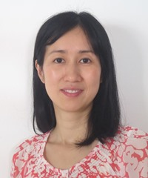
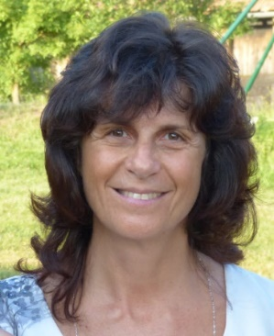
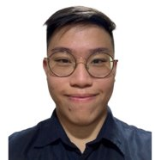

G1: Tue 8:15am
Instructors
  JIANG Jing
    jingjiang@smu.edu.sg
  Joelle ELMALEH
    joellee@smu.edu.sg
    @JoelleSMU
TAs
  Farand TAN Yong Rui
    farand.tan.2020@scis.smu.edu.sg
    @farand77
  Meryl LOW Yu Qi
    meryl.low.2020@scis.smu.edu.sg
    @meryllow

Slide 3
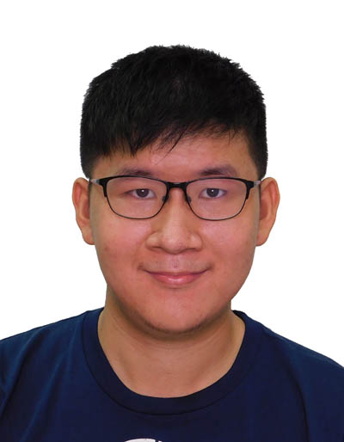
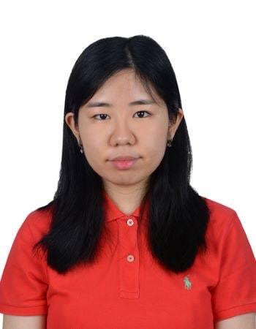
G2: Wed 8:15am
Instructors
  JIANG Jing
    jingjiang@smu.edu.sg
  Joelle ELMALEH
    joellee@smu.edu.sg
    @JoelleSMU
TAs
  Matthew CHANG Yu Ern
    yechang.2021@accountancy.smu.edu.sg
    @mchangye
  Davina WIJAYA
    davinaw.2021@scis.smu.edu.sg
    @phaandaa

Slide 4
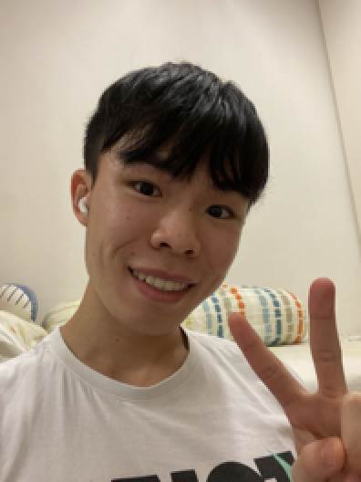
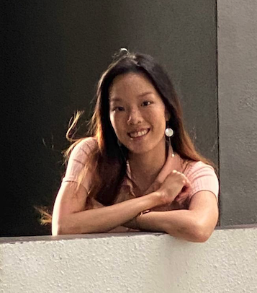
G3: Thu 8:15am
Instructors
  JIANG Jing
    jingjiang@smu.edu.sg
  Joelle ELMALEH
    joellee@smu.edu.sg
    @JoelleSMU
TAs
  Leroy TAN Jian-ly
    leroy.tan.2019@business.smu.edu.sg
    @CookiesLeroy
  Nolin HO Rui Ling
    nolin.ho.2020@scis.smu.edu.sg
    @noholin

Slide 5
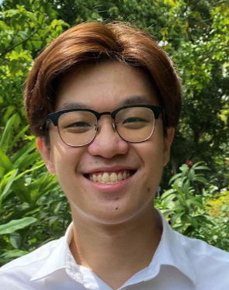
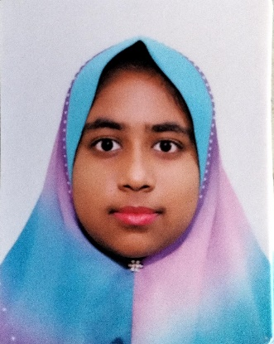
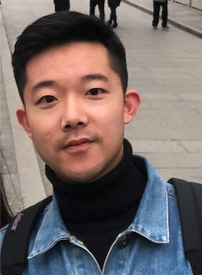
G11: Fri 12:00pm
Instructor
  Joelle ELMALEH
    joellee@smu.edu.sg
    @JoelleSMU
TAs
  Ang Wei Sheng
    wsang.2021@scis.smu.edu.sg
    @weishenggg
  Siti Shareefa
    sitisk.2021@scis.smu.edu.sg
    @cas_reefa
  Wang Qing
    qingwang.2020@phdcs.smu.edu.sg
    @IL1KETHAT

Slide 6
Consultation Hours
Jing (G1, G2 & G3)
  SCIS1 Room 4027
  Thursdays, 3:00 – 4:00pm
Joelle (G1, G2, G3 & G11)
  SCIS1 Level 2, Learning Way 2.1
  Wednesdays, 4:00 – 5:00pm
For the timeslots above, you do not need to make any appointment with us first.
If none of the timeslots for your section works for you, please email us to book a slot.

Slide 7
Course Objectives
Upon completion of this course, you should be able to
understand and apply the basic programming concepts to solve problems
understand and use two important data structures: list and dictionary
write simple Python scripts to handle simple tasks
In-Class Exercises
Lectures
Pre-class Preparation Materials
Labs

Slide 8
General Information
Python 3
Tools
  Anaconda Jupyter Notebook
  Notepad++ (Sublime Text for Mac users)

Slide 9
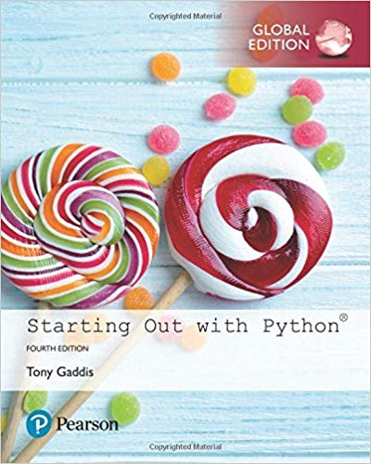
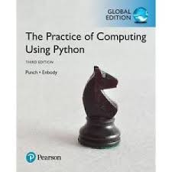
Reference Books
Starting Out with Python,
4th edition, by Tony Gaddis
  ISBN: 978-1292225753
  Available in SMU library under course reserves
The Practice of Computing Using Python (3rd edition) by Punch & Enbody
  ISBN: 978-0134380315
  Available in SMU library under course reserves

Slide 10
Lesson Plan
2022
Week | Topic | Assessment
1 | Introduction and fundamentals
2 | Functions
3 | Conditions and tuples | Quiz 1
4 | Strings and for-loops
5 | Lists | Quiz 2
6 | More on lists | Lab Test 1
7 | while-loops
8 | Recess Week
9 | File I/O | Quiz 3
10 | Dictionaries
11 | More on dictionaries | Quiz 4
12 | Integration of all concepts
13 | Review
14 |  | Lab Test 2
15 - 16 |  | Final Exam
15 Aug
22 Aug
28 Aug
In class Quiz
5 Sept
12 Sept
19 Sept
Saturday, September 24, 9:30 – 11:00am
26 Sept
3 Oct
10 Oct
In class Quiz
17 Oct
24 Oct
31 Oct
7 Nov
14 Nov
Monday, November 14, 9:30 – 11:00am
29 Nov – Tue – 0830 to 1030

Slide 11
Assessments
Class participation (5%)
Quizzes (10%)
Lab Test 1 (25%)
Lab Test 2 (25%)
Final Exam (35%)

Slide 12
Class Participation (5%)
Based on
  Self-check quizzes on eLearn (before class)
  Attendance
  Class participation (e.g., asking/answering questions, presenting your solutions on Padlet, etc.)
  Lab submissions (after class)

Slide 13
Assessments
Quizzes
  In-class. Taken on eLearn with LockDown Browser. You are not allowed to run your code.
Lab tests
  Taken on your laptop. You are allowed to run your code.
  Lab Test 1 (LT1):
    Saturday, September 24, 9:30 – 11:00am
  Lab Test 2 (LT2):
    Monday, November 14, 9:30 – 11:00am
    Please note that LT2 is in Week 14, when usually lessons are not conducted. If you have a class on Monday mornings, please check with that professor to find out whether you have class in Week 14.
Final exam
  Two-hour test. You are not allowed to run your code.
  Date/time/venue to be informed by RO.

Slide 14
Course Policies on Makeup Tests
Makeup lab test:
  Please inform us by Friday, September 2 (end of Week 3) if you have a conflict with either of the two lab tests.
    We will arrange a makeup depending on the demand.
    If you miss a lab test in unforeseen circumstances (e.g., MC), we will estimate a score for you. The estimation will be based on your performance on the other lab test, with adjustment based on the difficulty levels of the two lab tests.
  Quizzes:
    If you miss a quiz with a valid reason (e.g., MC), we will estimate a score for you based on your scores of the other quizzes and the difficulty levels of the different quizzes.

Slide 15
Course Policies (Attendance)
Attendance is compulsory. (Your TAs will take attendance every week.)
Two marks will be deducted from your final cumulative score for each lecture missed without a valid reason.
Missing three lectures without any valid reason will result in a final grade of F.

Slide 16
Course Policies (Final Grade)
If you score less than 50% in the final exam, you will receive an F, even if your cumulative score (calculated based on class participation, quizzes, lab tests and final exam) is more than 50%.

Slide 17
Lecture Style
Before each lecture
  Study carefully the topics to be covered using the Jupyter notebooks and other materials provided to you
During each lecture
  Actively work on in-class exercises and participate in discussions with classmates
After each lecture
  Work on lab exercises to review the topics covered.
Use the reference books and other online materials to learn more.

Slide 18
Labs
Additional exercises outside of class for practice
Not graded (but counts towards class participation).
You’re strongly encouraged to use them for learning and practice
Feedback on selected questions to be provided by TAs if you submit your solutions to eLearn

Slide 19
eLearn
Central place to download course-related materials
  Lecture notes (slides, other documents used in class)
  Pre-class materials
  Self-check quizzes
  Graded quizzes
  Labs
Place to check your grade after each assessment

Slide 20
Pedagogy Summary
Stage | Learning Material
Before class | Study carefully content of Jupyter Notebooks provided each week Self-check quiz (to test your understanding) Make multiple attempts if necessary Optional: Reference texts BE READY BEFORE COMING TO CLASS!
During class | Review of some important concepts Review of common mistakes of self-check quizzes if necessary ICE (In-class exercises) Ask questions. Make the session interactive! Discuss with peers
After class | ICE (cont’d) Complete and review Extra Exercises (more challenging) Lab Practice, practice, and more practice! Additional materials Use additional materials (e.g., videos and exercises from other sections) to reinforcement your understanding

Slide 21
Copyright Statement
Faculty members hold copyright to the original Course Materials that they create. These include written lectures, power point presentations, study materials, tests, pre-recorded video lesson, recordings of lessons conducted online and in the selection of readings and assignments for their courses.
Students are obliged to respect copyright and may use course notes and make copies of course materials for their own use only. They may not reproduce, or allow others to reproduce, adapt, distribute, upload or make available for sale, all lecture notes and course materials publicly in any way, without written consent from the copyright owner. The making or distribution of unauthorized copies of course materials is strictly prohibited, and any infringement may be subject to the disciplinary action by the University.

Slide 22
Questions?

